Slide 1




Capstone project
Detail study Plan
Understanding Customer Behavior
Unveiling Insights into Customer Behavior and Campaign Response Patterns
Retail Sales Case Study
Analysis by:
1.Jhansi.D
2.Anup Uppin
3.Supriya Kolhe
4.Nikita Bhanji
Class: ABADS 8B
April 5th ,2024

Slide 2
Contents
Data Understanding,
Preparation and Quality Assessment
Business Analysis
Conclusion
Business
Understanding
Part 01
Part 02
Part 03
Part 04

Slide 3

Part 01
Understanding

Slide 4

Business Understanding
Introduction:
Knowing how customers behave is super important in retail business.And using data to understand customer habits can really help improve marketing and make campaigns work better.
objective:
Our main goal is to look at the data to understand how customers act and respond to marketing. By doing this, our client wants to make their marketing campaigns better so they can get more customers involved and make more money. We'll tried to find out which types of customers like certain campaigns, how things like education,martial status affect what they buy, and if past marketing efforts worked well.

Slide 5
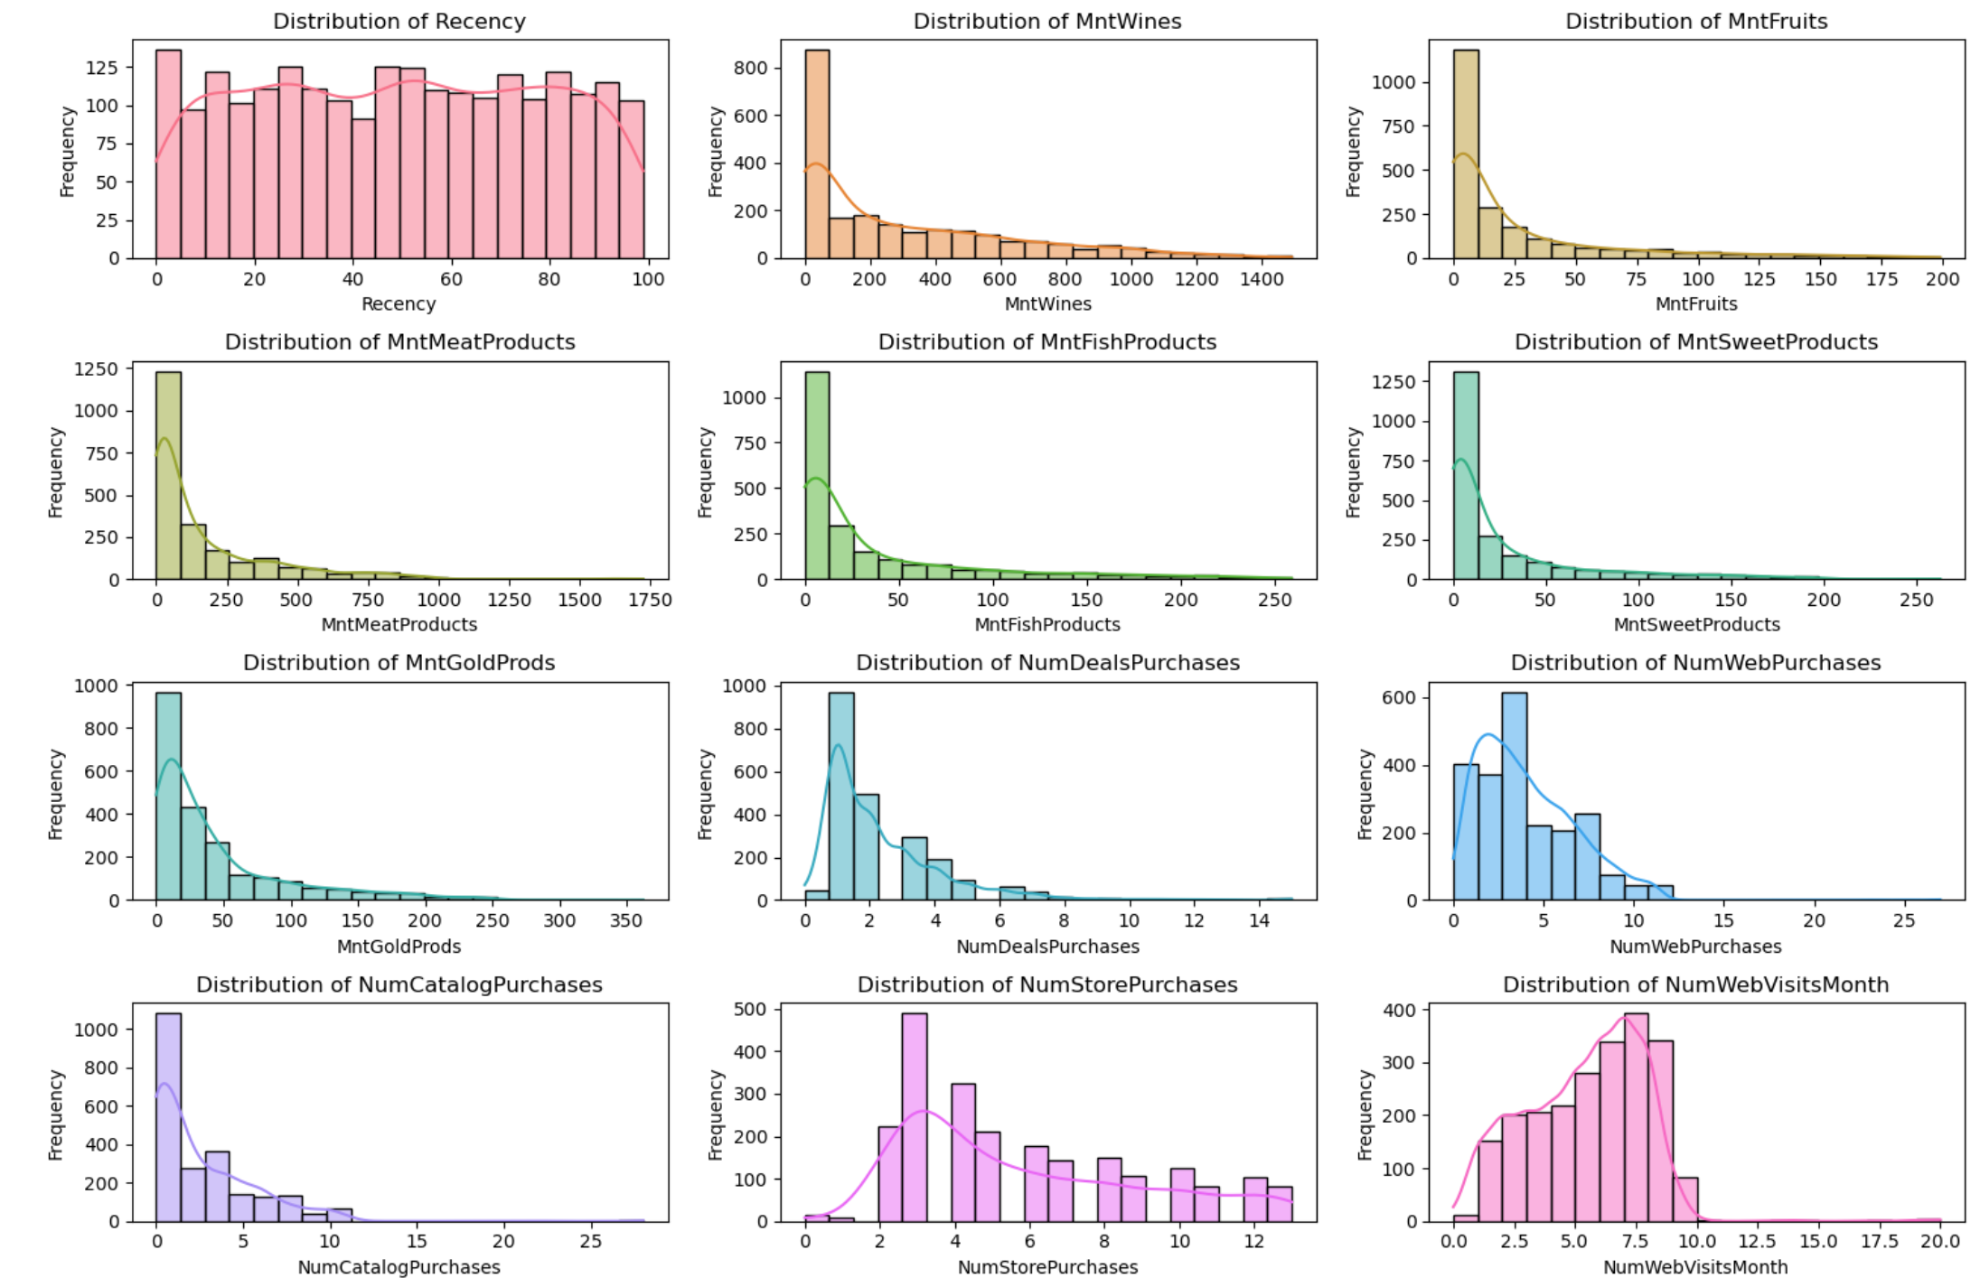
Behavioral Analysis:
Upon examining the distributions of various numerical variables, MntWines, MntFruits, MntMeatProducts, MntFishProducts, MntSweetProducts, and MntGoldProds showcase a distinctive right-skewed distribution. This inclination towards the higher end of the scale suggests a prevalence of higher expenditure.Interestingly, the positive skewness manifests in the distributions of NumDealsPurchases, NumWebPurchases, NumCatalogPurchases, and NumStorePurchases too.
In contrast the distribution of Recency presents a different narrative. Exhibiting a uniform distribution, this metric suggests a relatively consistent pattern.
Note that among these observations is the left-skewed distribution evident in NumWebVisitsMonth. The skewness is leaning towards visitation frequencies.

Slide 6
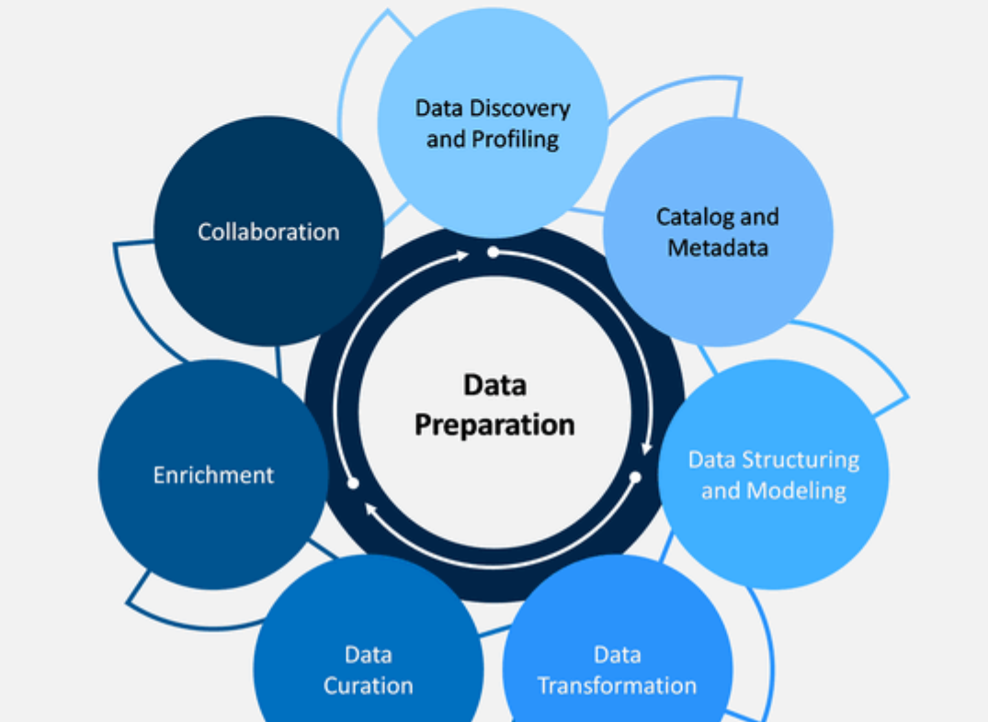
Part 02
Data
Understanding

Slide 7
Data preparation
Prepared a consolidated data view of datasets.Used json package and for loop for retreival of the json files.Merged three datasets using pd.merge and stored in the variable “TOTAL_DATA”.
Data understanding
The dataset provide comprises three main sources: demographics of customers, purchase behavior, and responses to marketing campaigns.
Data
Data cleaning
identified any errors, dulipcates or missing values in the data .Verified that there are no duplicate rows in the cleaned dataset. Overall, the cleaning process addressed potential issues such as leading/trailing whitespaces, currency symbols, and data type conversions, ensuring that the dataset is suitable for further analysis.
Data Quality Assessment:
Data quality report for continuous variables and categorial variable. A special chi-square test performed for categorial variable.

Slide 8
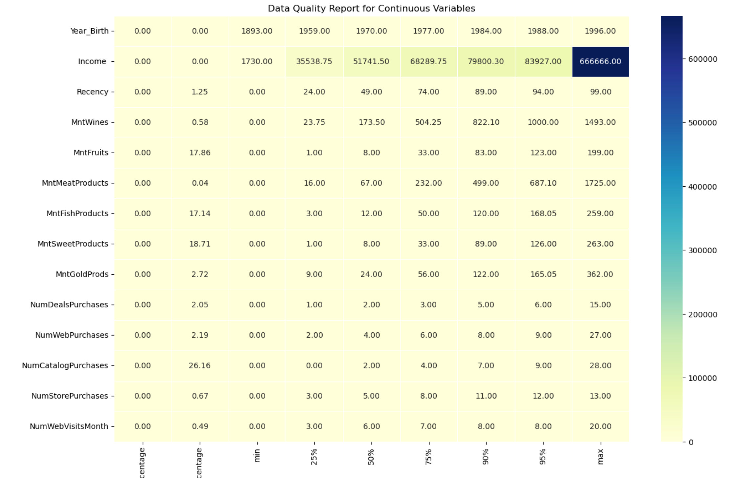
Data Quality Assessment
data quality report for continuous variables
Analysis :
Year_Birth indicating relatively low variability.
There are some outliers in income with the maximum income reaching 666,666.
on average, customers made purchases approximately 49 days ago. Suggesting some variability in the time since the last purchase among customers.
Purchase Behavior:Customers tend to purchase various types of products.But,there are significant percentages of zero purchases for fruits, fish, sweet products, and gold products. While wine and meat products seem to be popular .

Slide 9
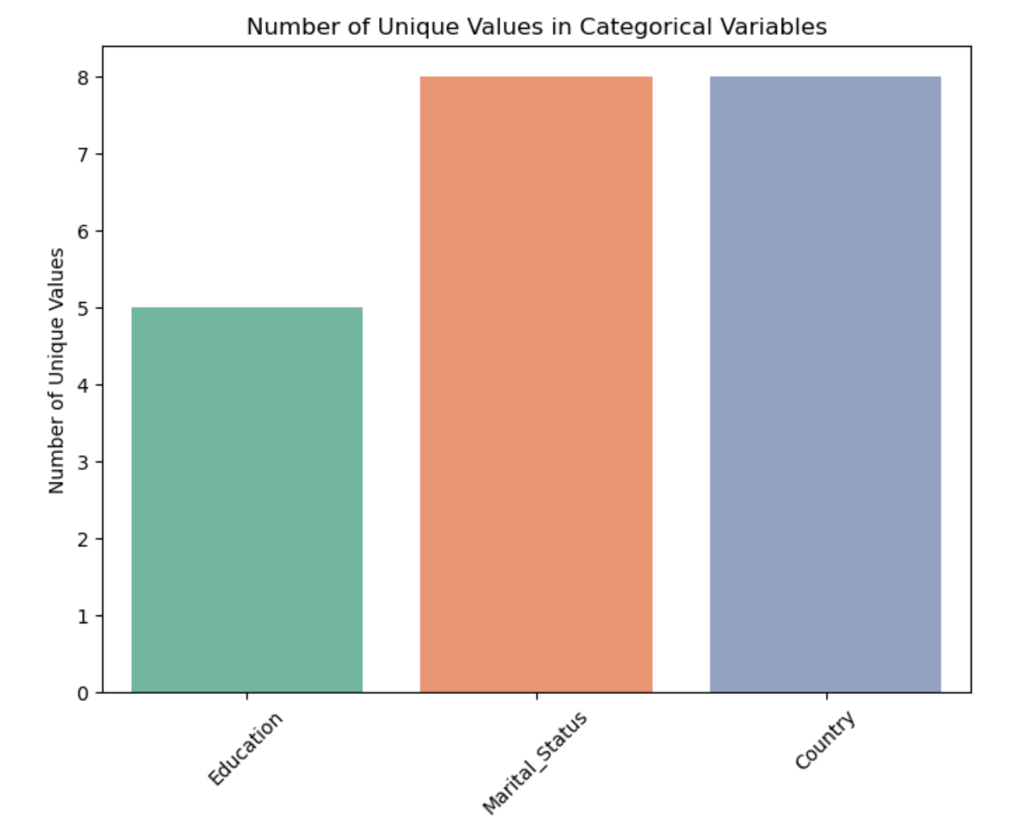
Data Quality Assessment
data quality report for categorical variables
Anaylsis
Missing Percentage: There are no missing values in the all the mention categorial variable.
Number of Unique Values: There are 5 unique education levels and 8 uniques martial status and countires respectively present in the dataset.
Count Unique: All 2240 entries have a non-null value for Education,martial status and country.
Top Category: The most common education level is "Graduation", with 1127 occurrences. "Married", with 864 occurrences in martial status.

Slide 10
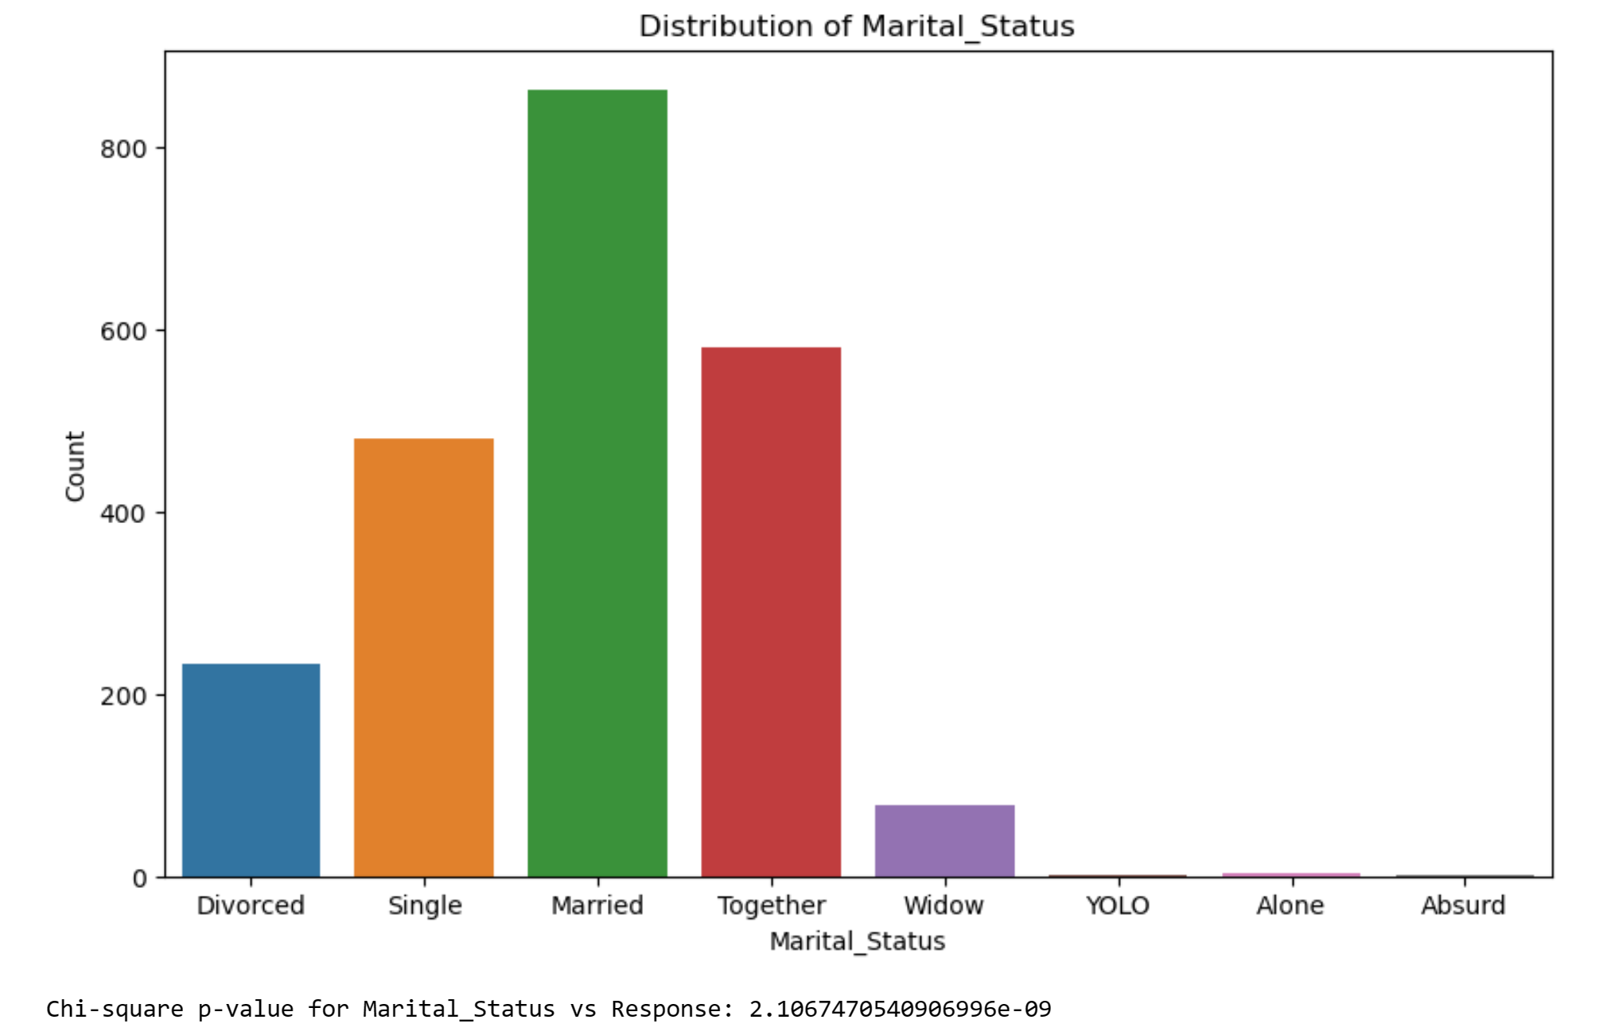
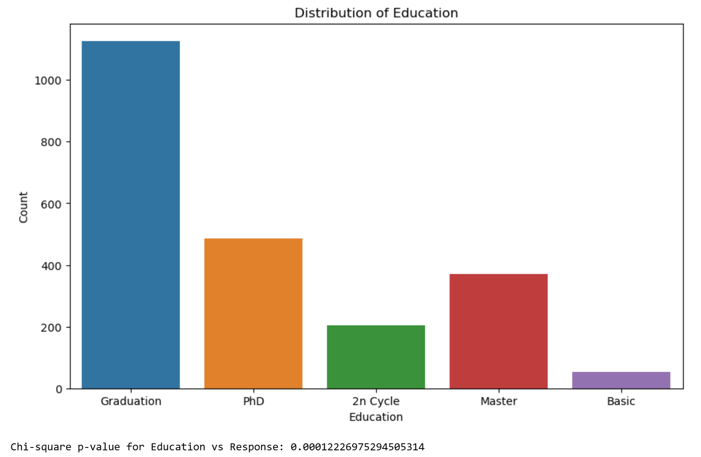
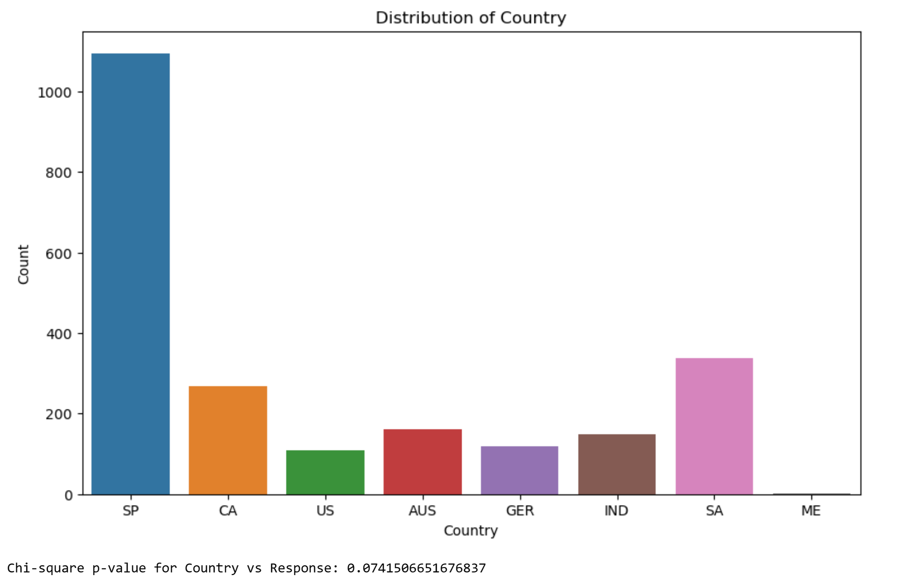
Data Quality Assessment
chi-square test for categorical variables
Marital_Status vs Response: The p-value (2.1067e-09) is significantly less than the significance level, suggesting a strong association between marital status and response to the campaign. Marital status appears to be a significant factor influencing the response rate.
Country vs Response:
The p-value (0.074) is greater than the significance level (e.g., 0.05), indicating that there is no statistically significant association between country and response to the campaign. Therefore, the country of residence may not play a significant role in determining the response rate.
Education vs Response:
The p-value (0.00012) is less than the significance level (e.g., 0.05), indicating a statistically significant association between education level and response to the campaign. Therefore, education level may have a significant impact on the response rate.

Slide 11
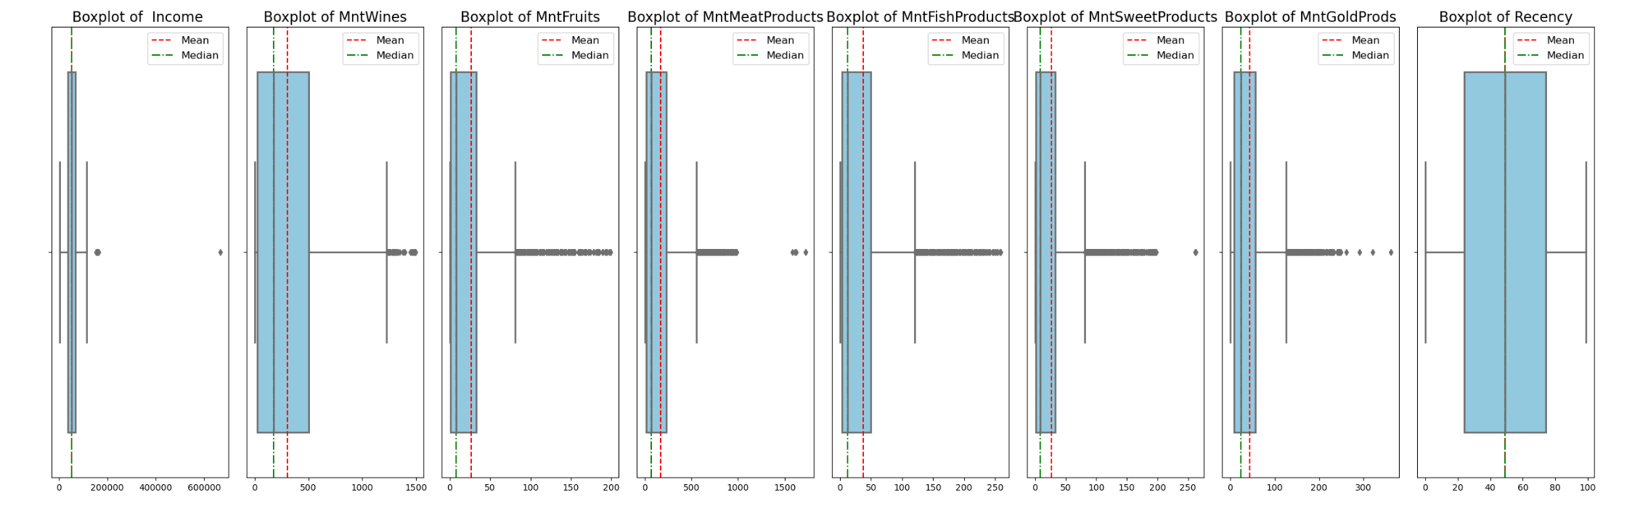
Data Quality Assessment
Checking for outliners
inferences:
Income: There are a few outliers in the higher income range, indicating the presence of individuals with significantly higher income levels compared to the majority.
Spending on Various Categories (MntWines, MntFruits, MntMeatProducts, MntFishProducts, MntSweetProducts, MntGoldProds):Each spending category shows varying degrees of skewness and presence of outliers, especially towards higher spending amounts.The presence of outliers suggests that there are customers who spend significantly more in certain categories compared to the rest.
Recency :There are no visible outliers in the recency variable, suggesting that the majority of customers have made recent purchases.

Slide 12




Hypothesis Generation and Testing
1.
Part 03
Funnel Analysis of Campaign Response
2.
Customer Profiling
6.
Campaign Response Comparison
5.
3.
Income Impact on Spending Behavior
4.
Customer Complaint Analysis

Slide 13
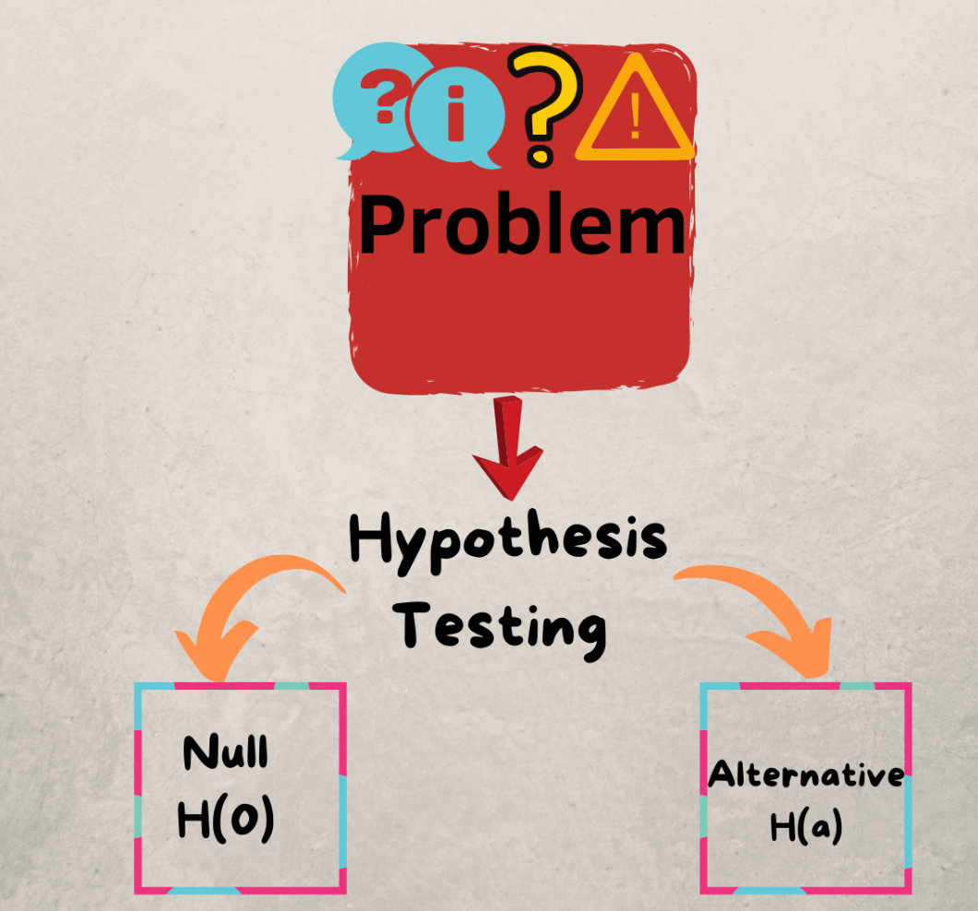
Hypothesis Testing
Hypothesis 1
Difference in mean amount spent on wines and fruits among responders.
Null hypothesis: There is no significant difference in mean amount spend on wines and fruits among responders.
Alternate hypothesis: There is significant difference in mean amount spend on wines and fruits among responders
As per analysis :
Among responders, there is a significant difference in the mean amount spent on wines compared to fruits, with respondents spending more on wines.
We reject the null hypothesis.
Hypothesis 2
Difference in mean amount spent on meat products between responders and non-responders in the 1st campaign.
Null hypothesis: There is no significant difference in the mean amount spent on meat products between responders and non-responders in the 1st campaign
Alternate hypothesis: There is a significant difference in the mean amount spent on meat products between responders and non-responders in the 1st campaign.
As per analysis :
The t-statistic of 12.7126 indicates a significant difference in the amount spent on meat products between customers who responded positively and those who did not in the 1st campaign. The p-value of 0.0000 is less than the conventional significance level, providing strong evidence to
We reject the null hypothesis.
Hypothesis 3
Correlation between amount spent on wines and response rate Customers who spent more on wines are more likely to respond positively to marketing campaigns.
Null hypothesis: There is no correlation between amount spent on wines and response rate.
Alternate hypothesis: There is a correlation between customers who spent more on wines are more likely to respond positively to marketing campaigns.
As per analysis :
The correlation coefficient of 0.1990 indicates a positive correlation between the amount spent on wines and the response rate. The p-value of 0.0000 is less than the conventional significance level (e.g., 0.05), suggesting that the correlation is statistically significant.
We reject the null hypothesis.

Slide 14
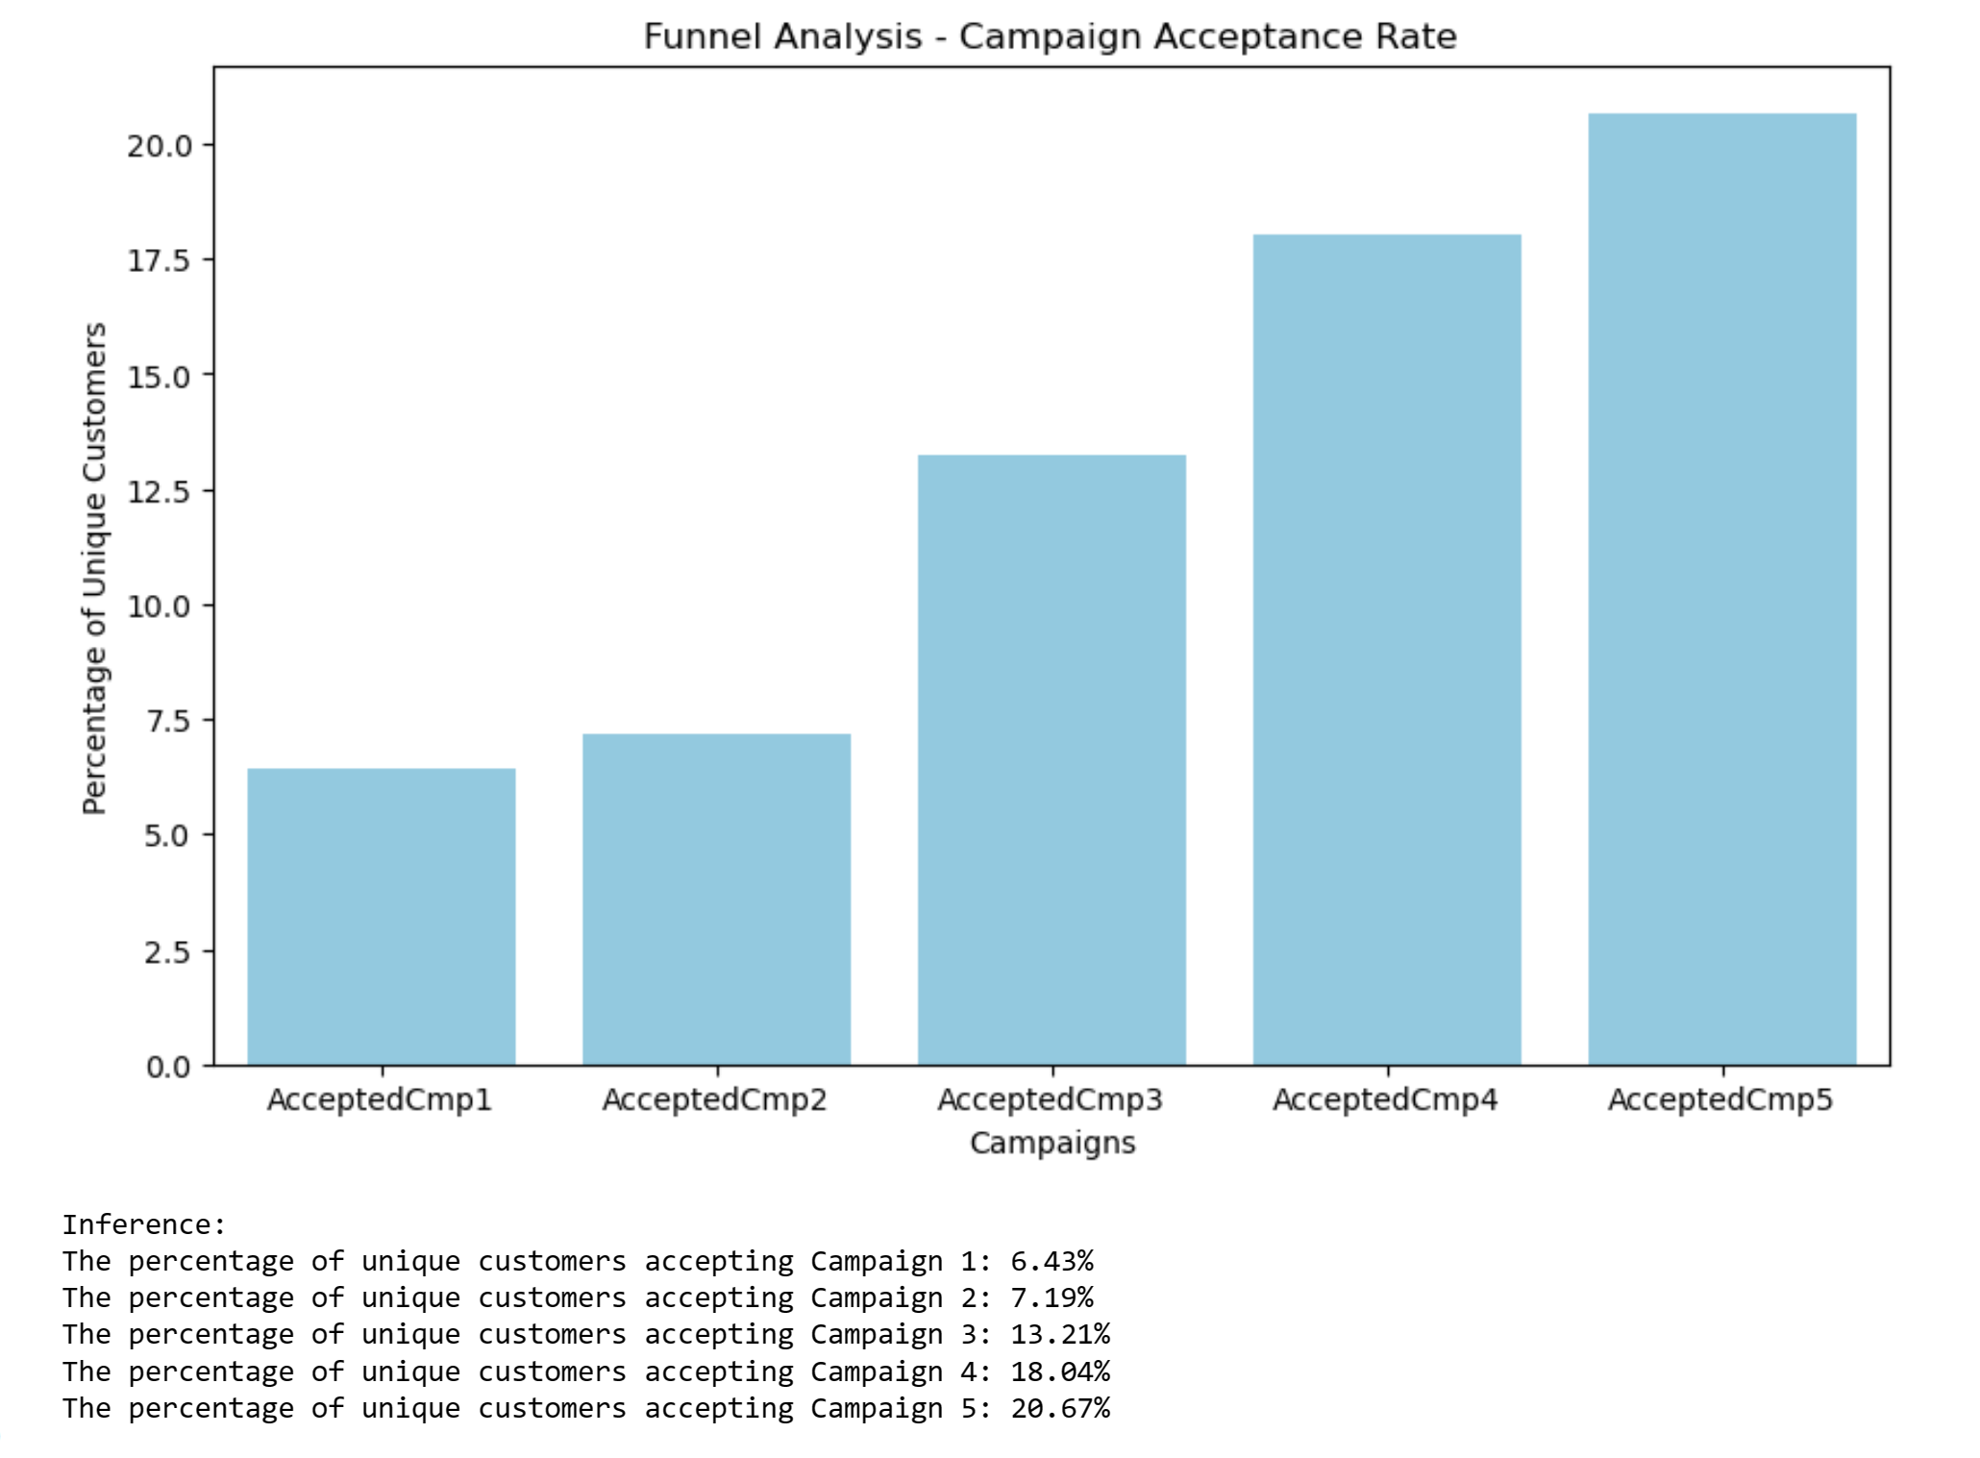
Funnel Analysis
Inference:
The analysis highlights varying acceptance rates among unique customers across different campaigns. Campaigns 4 and 5 exhibit notably higher acceptance rates of 18.04% and 20.67%, respectively, indicating their effectiveness in engaging customers compared to the earlier campaigns.

Slide 15
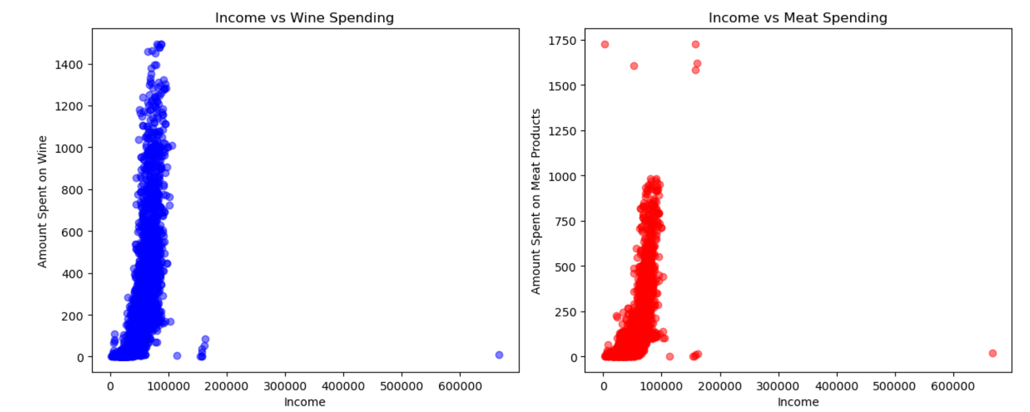
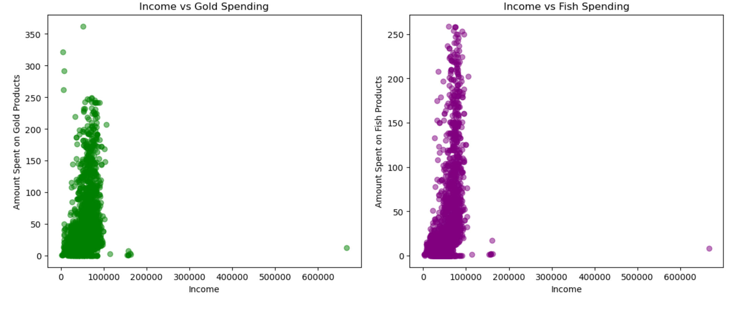
Income Impact on Spending Behavior
Intercepts:
1.The intercept represents the expected amount spent on each category when income is zero.
2. For Wine and Meat Products, the intercepts are negative, indicating that without income, there would be negative spending, which is not meaningful in this context.
3.For Gold Products, the intercept is positive, indicating that even without income, there is some expected spending.
4.For Fish Products, the intercept is negative, indicating that without income, there would be negative spending, which is not meaningful.
Inferences:
As income increases, there is a positive impact on the amount spent on Wine, Meat Products, Gold Products, and Fish Products. The impact of income appears to be the highest on Wine spending, followed by Meat Products, Fish Products, and then Gold Products.

Slide 16
Customer Complaint Analysis
Campaign Response Comparison
Based on the statistical analysis conducted using a t-test, comparing complaint rates between recent and older customers, the following conclusions can be drawn:
Null Hypothesis: There is no significant difference in complaint rates between recent and older customers.
Alternative Hypothesis: Recent customers complain less in general compared to older customers.
The t-statistic obtained was 0.6063 with a corresponding p-value of 0.5476. With a significance level (alpha) of 0.05, we fail to reject the null hypothesis since the p-value is greater than alpha. This indicates that there is no significant difference in complaint rates between recent and older customers.
Conclusion:
Based on the analysis, there is no evidence to suggest that recent customers complain less compared to older customers. Therefore, we do not have sufficient statistical evidence to conclude that there is a significant difference in complaint rates between these two groups of customers.
Do people who accept the offer in the first campaign also accept in any other campaign?
The output of the chi-square test of independence shows a chi-square statistic of 0.0 and a p-value of 1.0.
The p-value represents the probability of observing the data given that the null hypothesis (independence between accepting the first campaign and accepting any other campaign) is true. A p-value of 1.0 suggests that there is no evidence to reject the null hypothesis. Since the p-value is very high (1.0), we fail to reject the null hypothesis.
Therefore, there is no statistically significant relationship between accepting the first campaign and accepting any other campaign.
Accepting the first campaign does not influence the likelihood of accepting any other campaign. These events appear to be independent of each other.
Overall, based on the statistical analysis, we can conclude that accepting the offer in the first campaign does not influence the likelihood of accepting any other campaign.

Slide 17
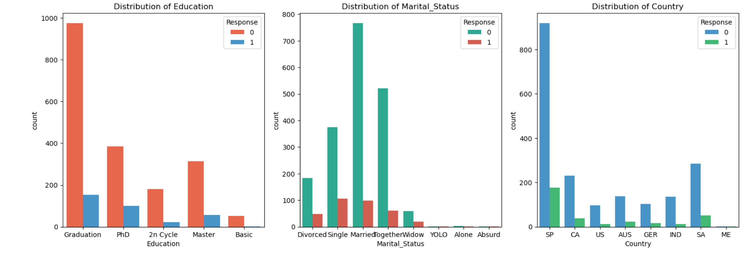
Customer Profiling
Profile of people who respond vs who don't
Upon scrutinizing the categorical features, a consistent trend emerges wherein non-responders constitute the majority across all facets, encompassing education, marital status, and country. Remarkably, responders appear to be less prevalent across the board. Interestingly, the categories with the highest incidence of non-responders coincide with those witnessing the greatest response rates.

Slide 18
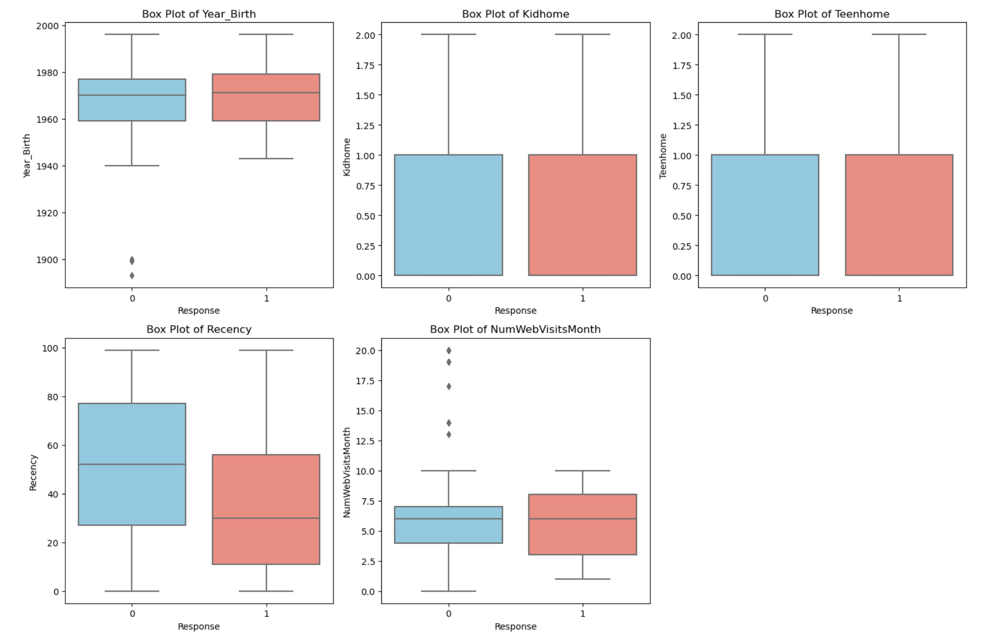
Analysis of Numerical Features:
Younger customers tend to respond more positively to the campaigns.
Customers with fewer kids and teenagers at home are more likely to respond to the campaigns. This suggests that customers with fewer familial responsibilities might be more receptive to marketing efforts.
Recent customers, represented by a shorter recency are more likely to respond to the campaigns. This underscores the importance of targeting recent customers with timely marketing initiatives.
Customers who visit the website more frequently per month tend to have a higher response rate. This suggests that online engagement plays a significant role in campaign responsiveness, and targeting customers who are more active online may yield better results.

Slide 19
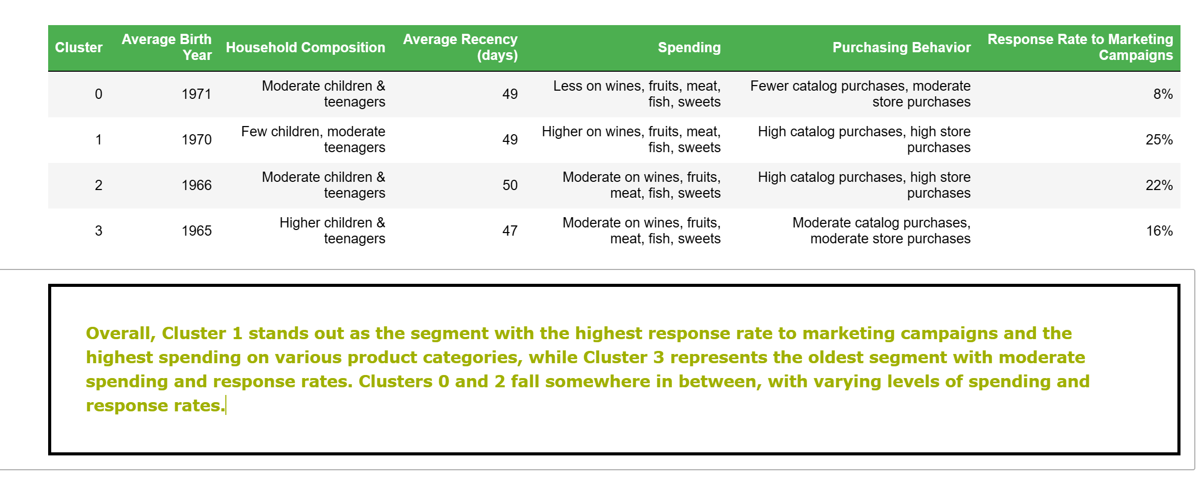
Part 04
Conclusion (K-means cluster)

Slide 20

Analysis by:
Jhansi.D
Anup Uppin
Nikita Bhanji
MEDUIM BLOG POST LINK
THANK YOU
Analysis by:
1.Jhansi.D
2.Anup Uppin
3.Supriya Sominath Kolhe
4.Nikita Bhanji

